Slide 1
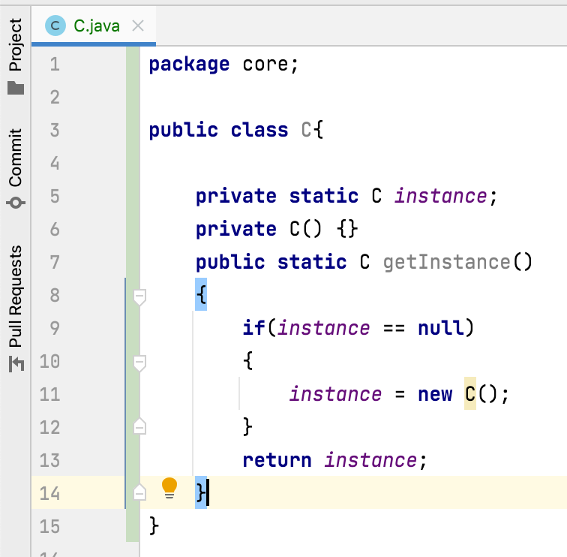
What is the use of private constructors?
Private constructors are used to restrict the instantiation of a class.
When a class needs to prevent other classes from creating its objects
then private constructors are suitable.
Objects to the class which has only private constructors
can be created within the class.
Example : singleton pattern
This ensures only one instance of a class exist at any point of time.

